Slide 1

Armed Forces College of Medicine
AFCM

Slide 2
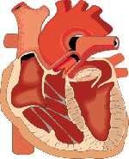
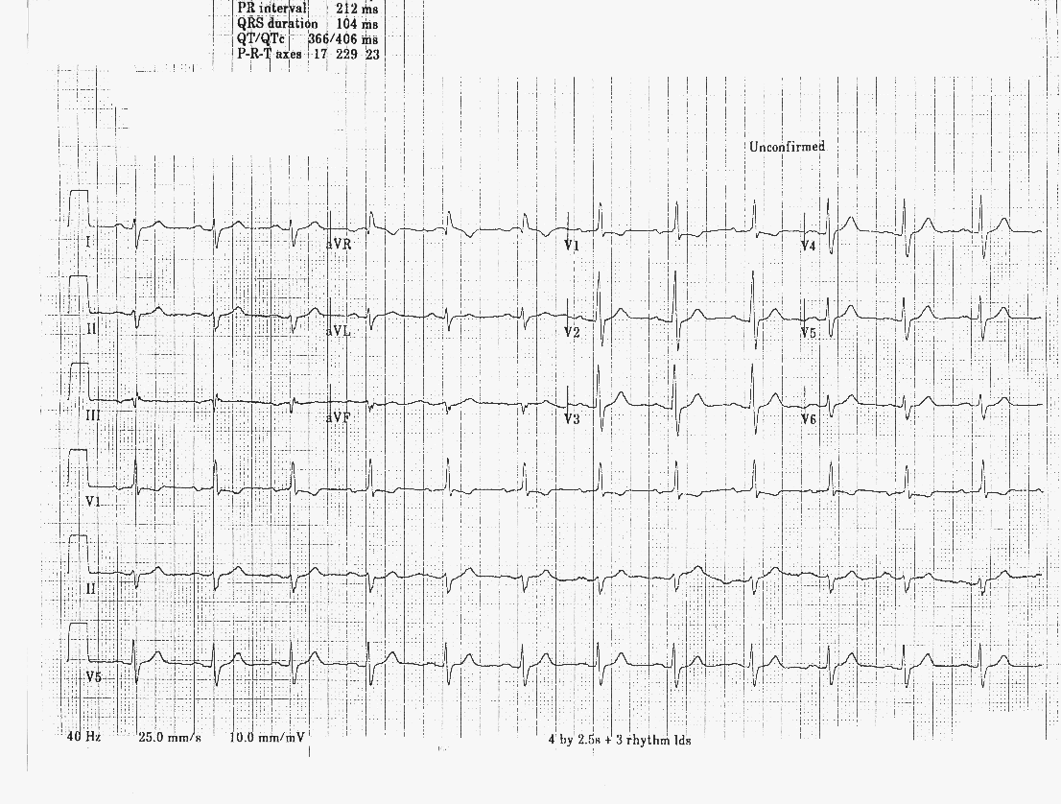
Normal Electrical Pathway
SA node
AV node
Bundle of His
SA
Bundle Branches
AV
HIS
BB

Slide 3
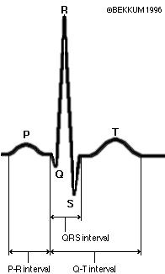
Arrhythmia
BY
Ahmed Salah Salem, MD.
Lecturer of Cardiology.

Slide 4
NORMAL EKG
P wave: atrial activity
Q wave: first downward deflection from isoelectric line (t-p)
R wave: first upward deflection from isoelectric line
S wave: second downward deflection

Slide 5
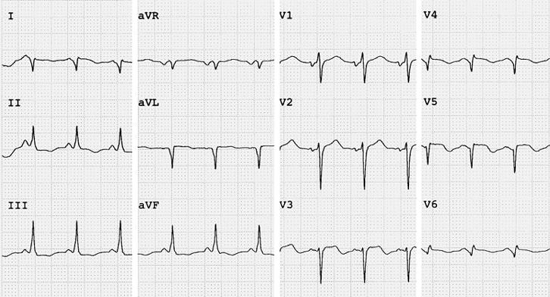
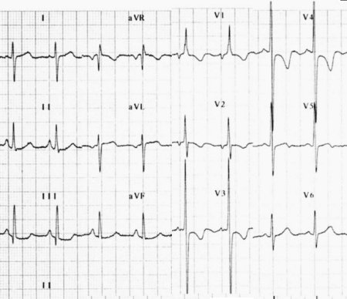
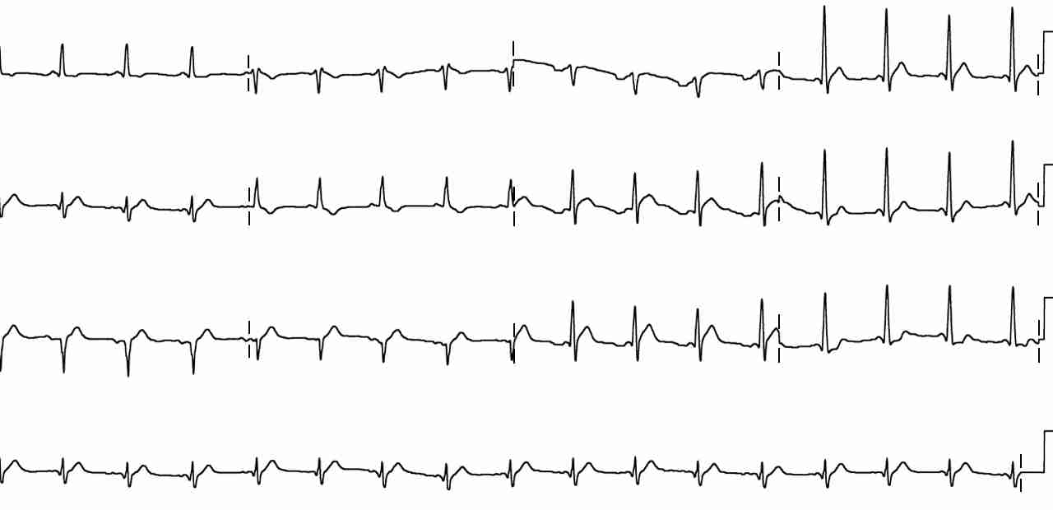
NORMAL EKG
qRs: small downward deflection, large upward deflection, and small downward deflection
rS: small upward deflection, and large downward deflection
Qr: large downward deflection, and small upward deflection
Rs: large upward deflection, and small downward deflection

Slide 6
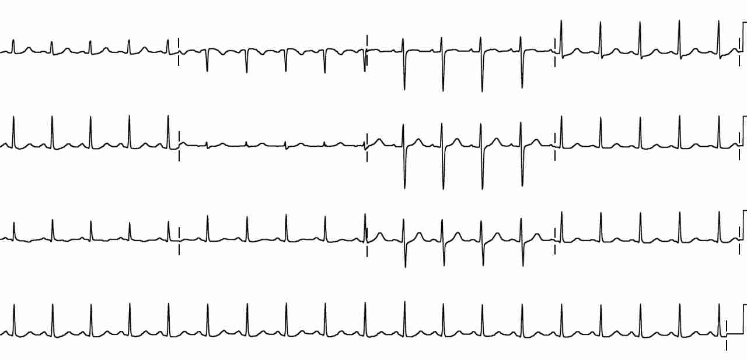
AXIS: NORMAL EKG - positive polarity(tall R) in inferior and lateral leads with increasing positive polarity (r-wave progression) across the precordium V1-6
I
AVR
V1
V4
II
V2
V5
AVL
V6
V3
III
AVF

Slide 7
In a “normal” patient the only leads that should have negative polarity are AVR and V1-2
---To determine axis: Look at leads I and AVF
I
AVR
V1
V4
II
V2
V5
AVL
V6
V3
III
AVF

Slide 8
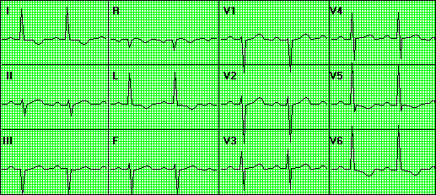
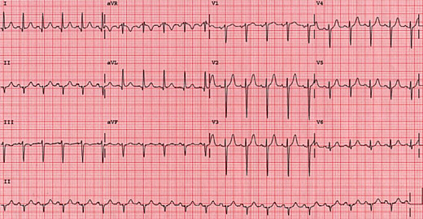
LAD - negative polarity (rS) in AVF

Slide 9
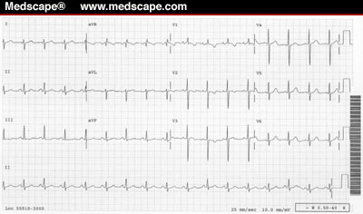
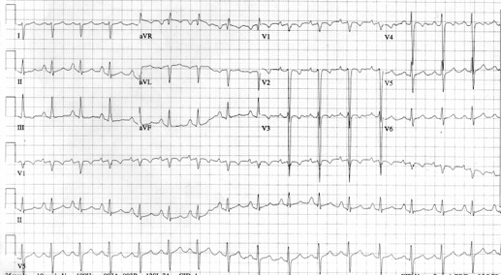
RAD: negative polarity(rS) in lead I

Slide 10
BUNDLE BRANCH BLOCKS
Unifascicular
Right BBB
Left Hemiblocks
Left anterior OR
Left posterior
Bifascicular
Left BBB (implies both hemiblocks present)
Right BBB PLUS
Left anterior
Left posterior
Trifascicular
Bifasicular PLUS AV nodal block

Slide 11
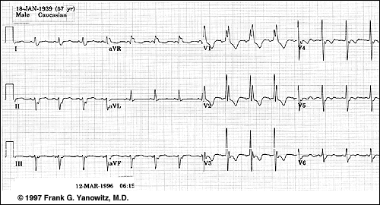
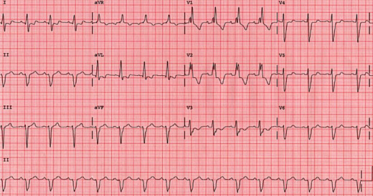
Right Bundle Branch Block
QRS > 0.12 sec
Predominantly positive rSR’ in
V ₁₋₂
Wide slurred S in lead I

Slide 12
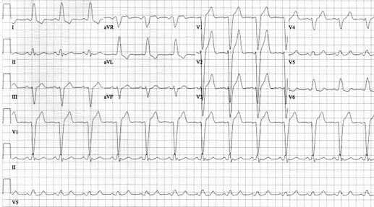
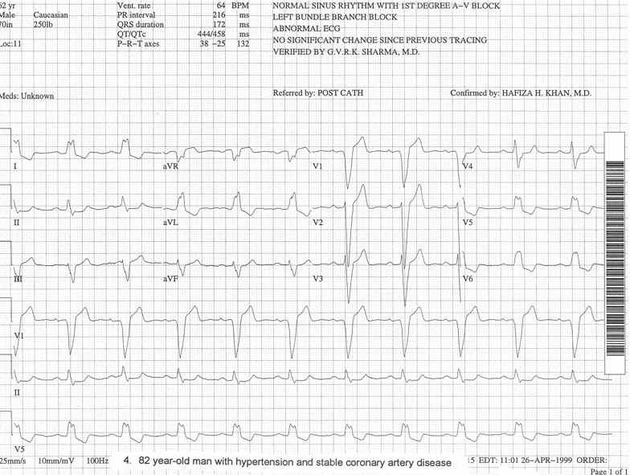
LEFT BUNDLE BRANCH BLOCK
Left bundle branch block (Both fascicles are blocked)
QRS > 0.12 sec
Deep S in V ₁₋₃
Tall R and RsR’ in lateral leads: I, AVL, & V ₅₋₆

Slide 13
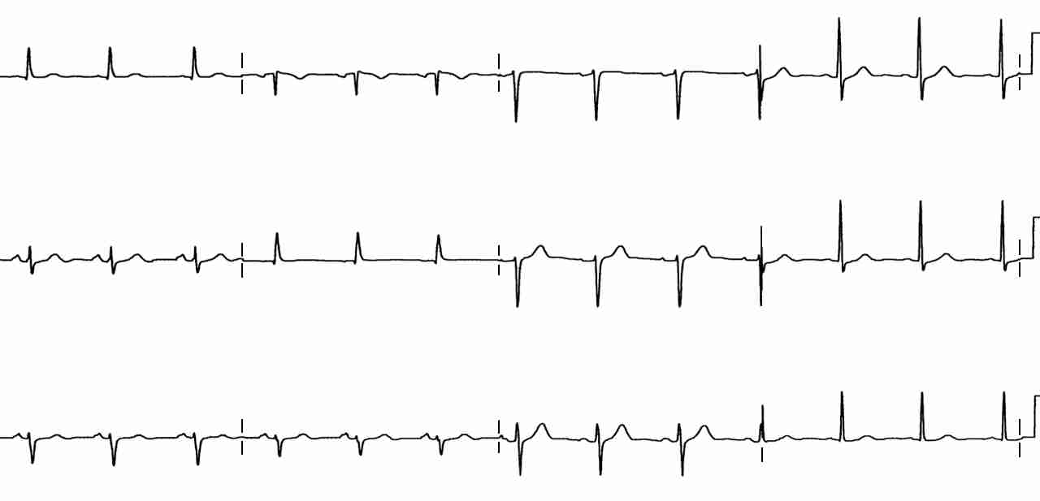
Left bundle divides into anterior and posterior branches
Left anterior fascicular block
Left axis deviation: negative polarity (rS) of AVF
rS waves in Inferior leads
Small Q in I (qR)

Slide 14
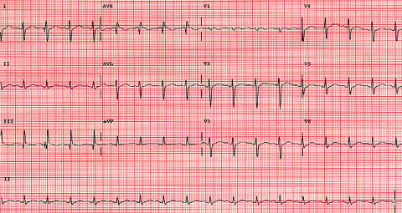
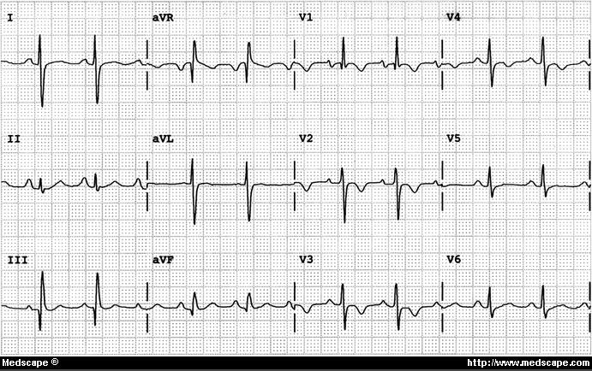
Left posterior fascicular block
Right axis deviation
RAD = negative polarity (rS) of Lead I
Small Q in III (qR)

Slide 15
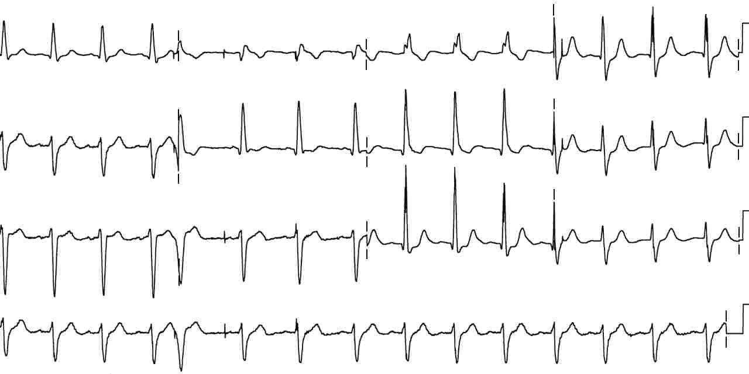
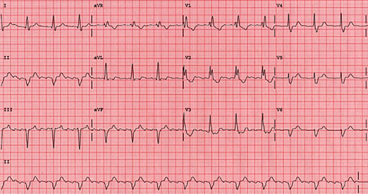
BIFASCICULAR BLOCKS
Right bundle branch block associated with Left anterior fascicular block
rS in AVF
qR in I

Slide 16
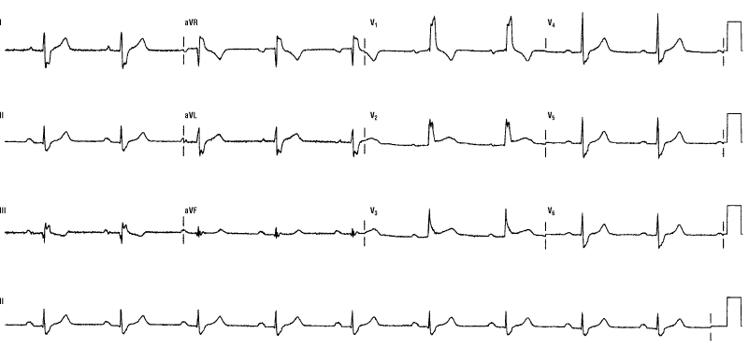
BIFASCICULAR BLOCKS
Right bundle branch block associated with Left posterior fascicular block -- uncommon
RBBB
RAD – rS I
plus qR III

Slide 17
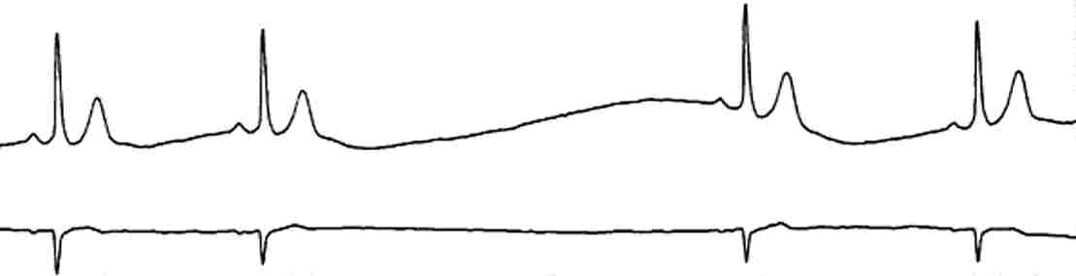
SA BLOCK
Sinus pause : 1 - 2 second pause
sinus beat resumes
Sinus arrest : > 2 seconds
junctional escape beat intervenes at 40-55 bpm
ventricular escape beat at 20 -40 bpm

Slide 18
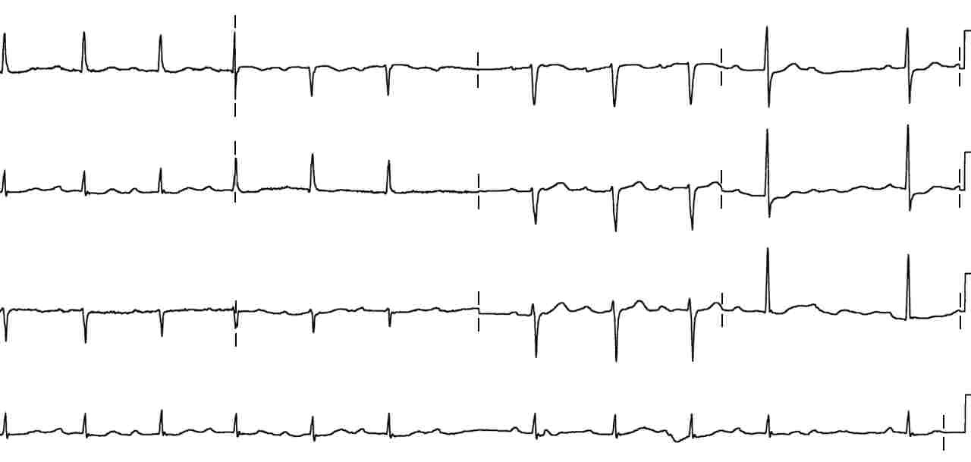
AV-BLOCKS
1st degree - PR > 0.2 sec

Slide 19
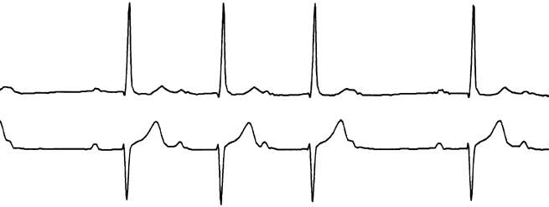
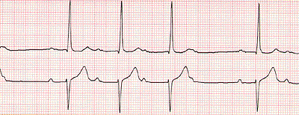
AV-BLOCKS
2nd degree
Mobitz I (Wenckebach) PR increases until a QRS is blocked
dropped

Slide 20
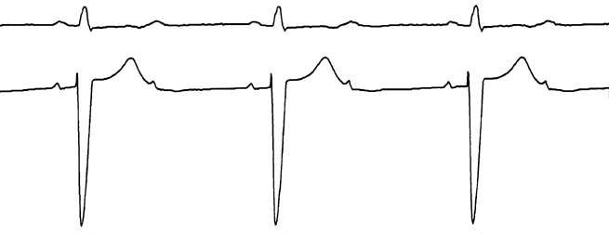
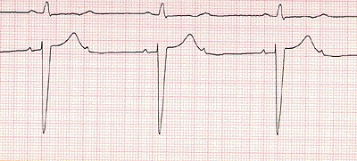
AV-BLOCKS
2nd degree
Mobitz II - blocked QRS (2:1, 3:1, 4:1)
PR interval is fixed and usually normal, then p-waves with dropped beats

Slide 21
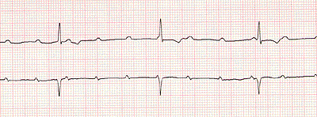
AV-BLOCKS
3rd degree - disassociation of PP and RR, the PP intervals and RR intervals are constant.
PP
RR

Slide 22
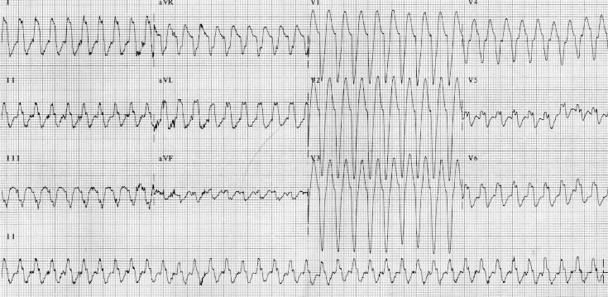
Tachyarrhythmias

Slide 23
TYPES OF DYSRHYTHMIAS
Re-entry (SVT, WPW)
Two parallel pathways with different rates and refractory periods
Something alters the refractory period and the alternative pathway becomes dominant
This causes a unidirectional conduction block, and a circuitous conduction pathway forms.
PAC

Slide 24
TYPES OF DYSRHYTHMIAS
Enhanced or Triggered (PACs, PVCs, Afib, MFAT)
Conduction cells act as Pacemaker cells
Conduction cells can be enhanced and become dominant in the setting of ischemia, sepsis, electrolyte imbalance or toxins.
Some dysrhythmias start with enhanced or triggered activity, but follow a circuitous pathway seen in re-entry. (Atrial flutter, Vtach)

Slide 25
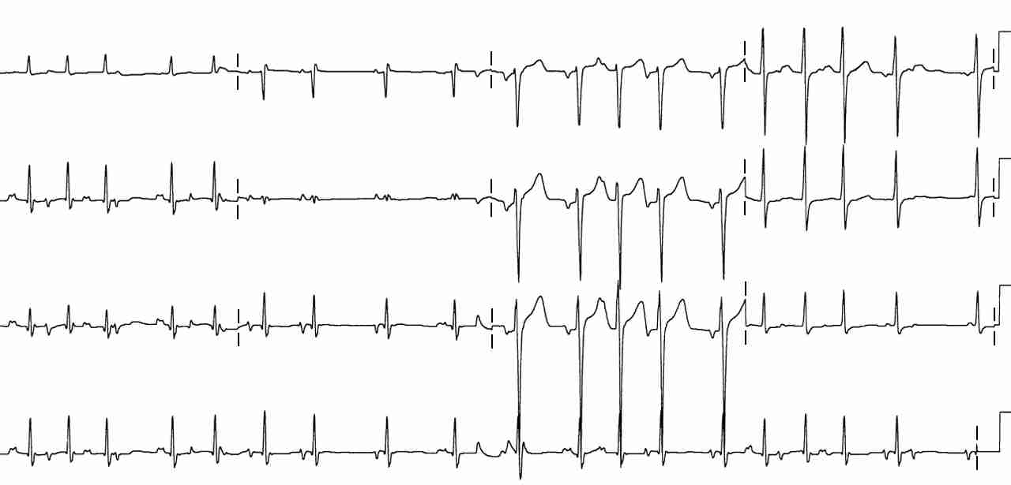
A 60 yo with COPD c/o palpitations & SOB. The EKG shows: a. Atrial Fibrillation
b. Premature Atrial Complexes
c. Multi-Focal Atrial Tachycardia
d. Paroxismal Atrial Tachycardia with block

Slide 26
MULTIFOCAL ATRIAL TACHYCARDIA (MFAT)
P waves of at least 3 different shapes
No dominant atrial pacemaker
Rate greater than 100 bpm
Varying PR, RR, and PP intervals
Enhanced or triggered automaticity

Slide 27
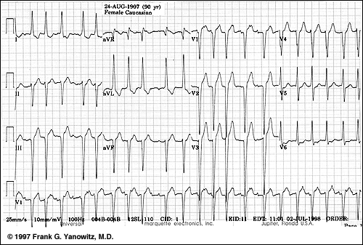
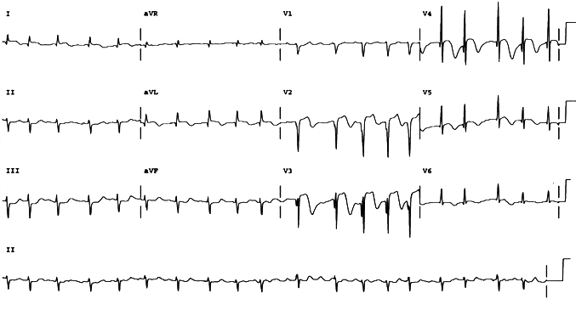
MFAT - CLINICAL SIGNIFICANCE
Hypoxia
COPD
Methylxanthene toxicity
CHF or sepsis
Treat the underlying disease process causing the triggered automaticity
OXYGENATION and PERFUSION
Magnesium Sulfate
Calcium channel blocker for rate control prn

Slide 28
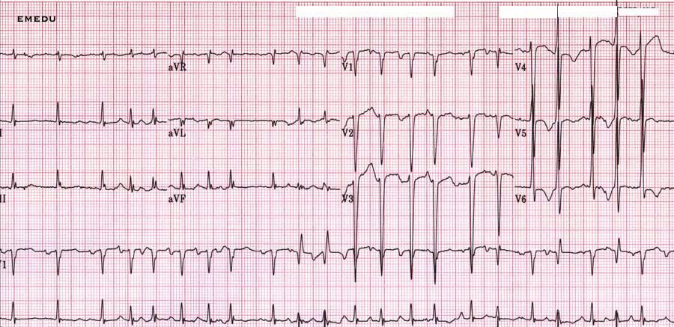
MULTIFOCAL ATRIAL TACHYCARDIA (MFAT)
P waves of at least 3 different shapes
No dominant atrial pacemaker
Rate greater than 100 bpm
Varying PR, RR, and PP intervals

Slide 29
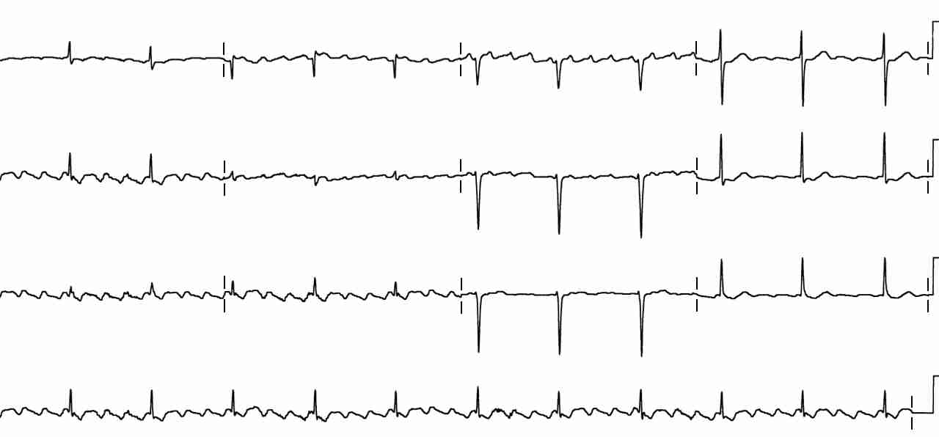
A 56 year old presents with palpitations. EKG shows: a. Atrial fibrillation
b. Atrial flutter
c. Left anterior fasicular block
d. RBBB

Slide 30
B. ATRIAL FLUTTER : Rapid, regular flutter (F) waves at 250-350 per minute (ventricular conduction 1:2, ie ~150bpm)
Sawtooth pattern of F waves in leads 2, 3 and AVF
Little evidence of atrial activity in lead 1
AV conduction variable, QRS typically normal width
Enhanced automaticity leading to circuitous conduction/reentry

Slide 31
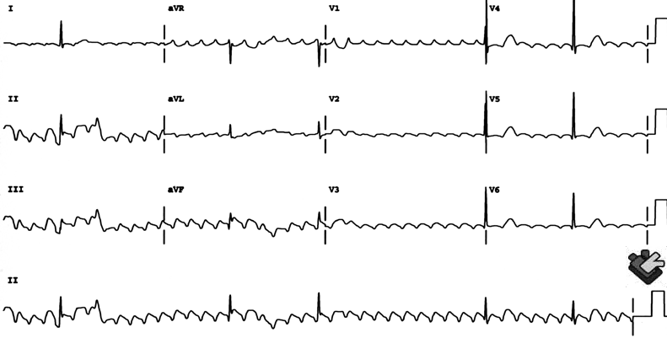
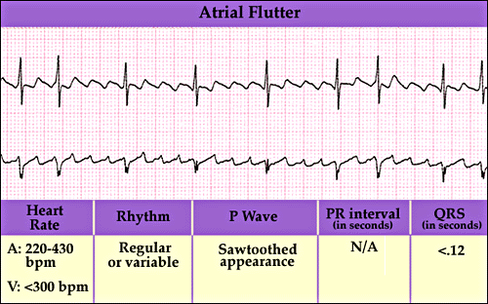
ATRIAL FLUTTER - TREATMENT
Atrial flutter is the most electrosensitive of all dysrhythmias therefore cardioversion is the treatment of choice for conversion to sinus rhythm.
Drug of choice for rate control is Calcium channel blockers.
Drug of choice for diagnostic purposes is Adenosine (as long as QRS is narrow

Slide 32
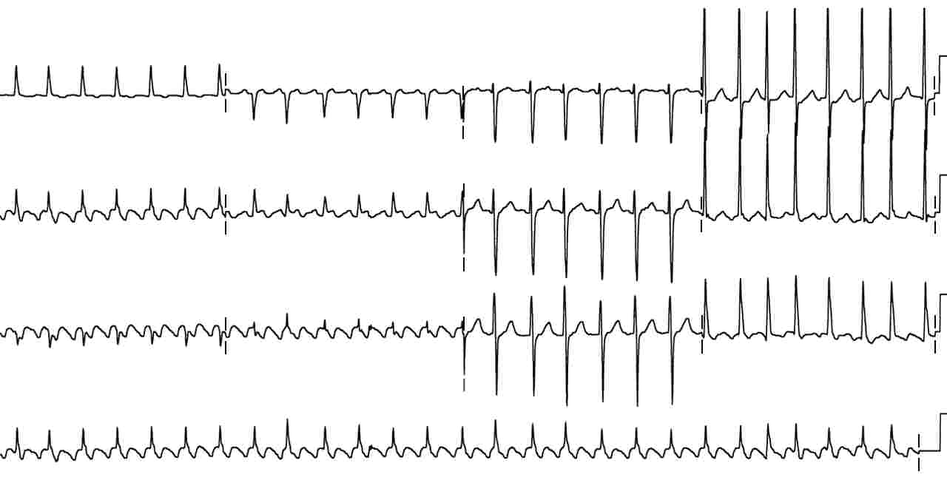
Atrial flutter with 2:1 conduction is often confused with SVT
But, look for the sawtooth flutter waves in the inferior leads.

Slide 33
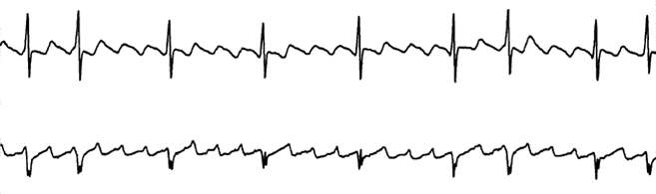
Same patient after adenosine, showing prominent flutter waves.

Slide 34
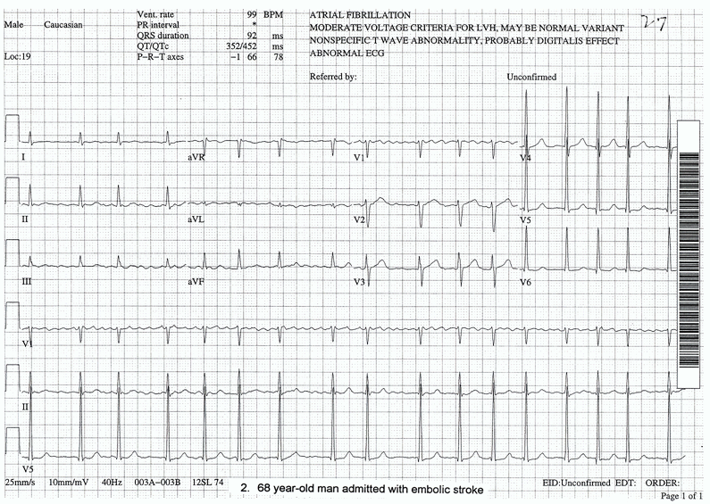
A 46 year old presents with palpitations. EKG shows: a. Atrial fibrillation
b. Atrial flutter
c. Left anterior fasicular block
d. RBBB

Slide 35
EKG shows: a. Atrial fibrillation
Prominent fibrillatory waves in V ₁₋₃ & AVF
Irregular ventricular response, greater than 100 / min
Ventricular rate less than 100 implies AV block
Triggered/enhanced automaticity

Slide 36
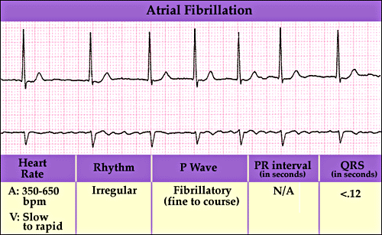
ATRIAL FIBRILLATION - treatment
Cardiovert if unstable
Ca Channel Blocker- Drug of choice for rate control
Beta blocker
Digitalis
Oral anticoagulation according to CHADS2Vasc score
the longer the patient has been in afib, the less likely you will be able to convert to NSR

Slide 37
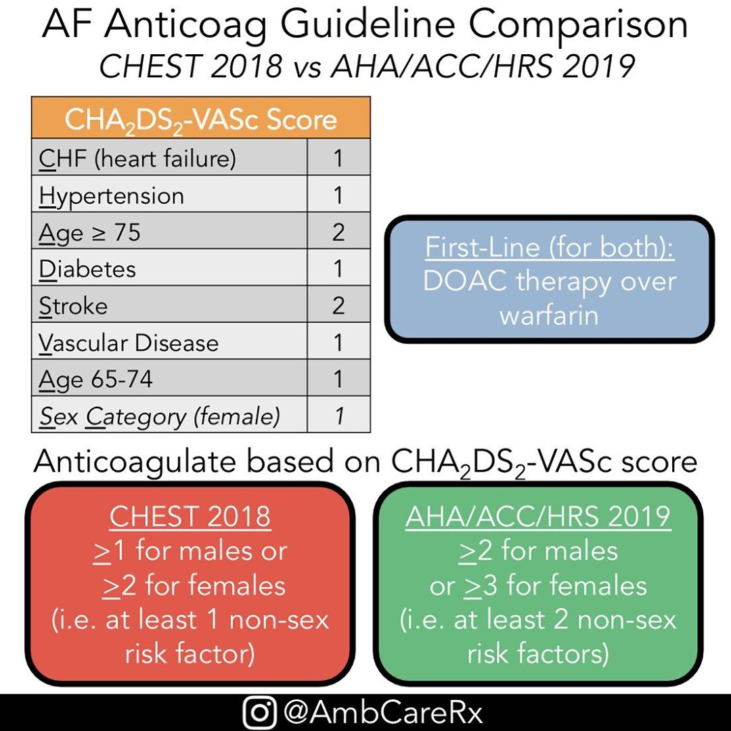

Slide 38
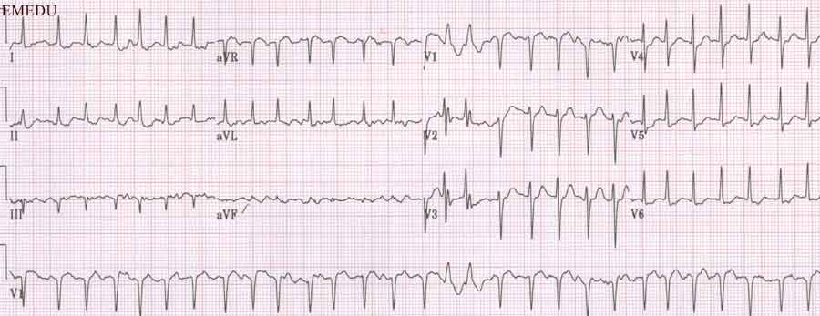
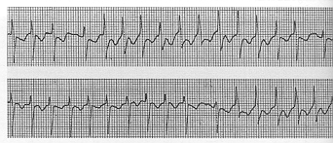
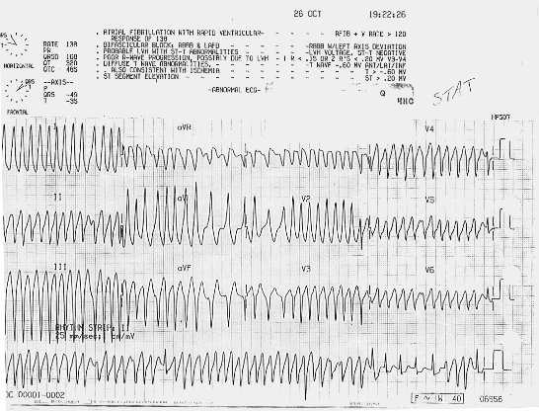
Ashman’s phenomenon – short runs of wide complex tachycardia during rapid atrial fibrillation.
The refractory period is rate-related, and when erratic changes in rate occur, an impulse conducted during the refractory period will have an aberrant (RBBB) pattern.

Slide 39
The most common dysrhythmia associated with digitalis toxicity is:
A. Paroxysmal atrial tachycardia with AV nodal block
B. Premature ventricular contractions
C. Second degree AV nodal blocks
D. Ventricular tachycardia
E. Junctional tachycardia

Slide 40
DIGITALIS TOXICITY - DYSRHYTHMIAS
Most common : b. PVCs
Most pathognomonic : PAT w/block
Others
AV nodal blocks
sinus bradycardia, pause, SA block
junctional escape beats or tachycardia
Ectopic SVT, V-tach, V-fib

Slide 41
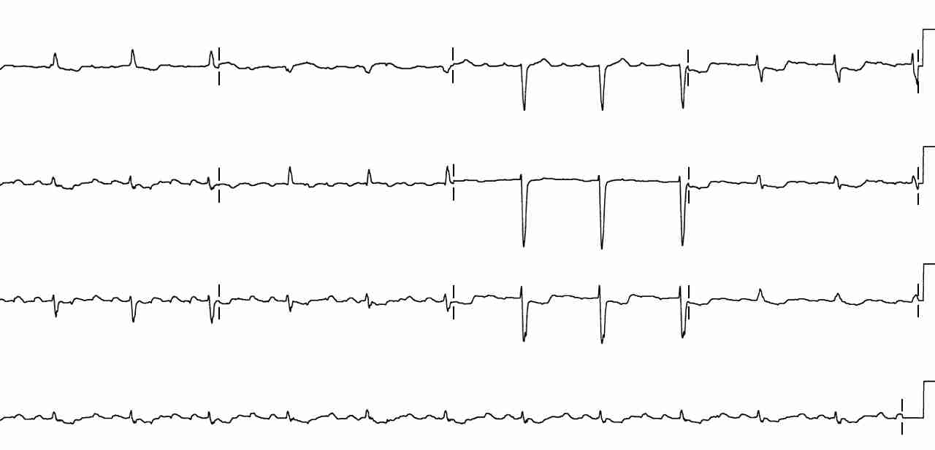
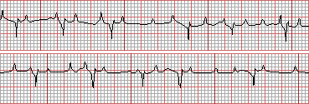
Paroxysmal atrial tachycardia with block is pathognomonic for digitalis toxicity.
Note the p waves at a rate > 100 & blocked QRS complexes.
(Don’t mistake for aflutter with variable conduction or 3rd degree block)
Note the blocked
Impulses!!

Slide 42
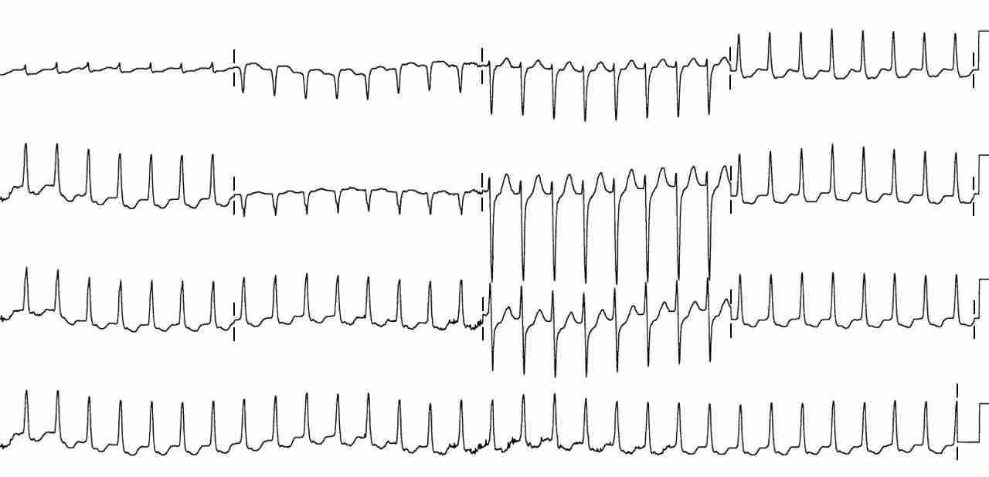
A 23 yo male with c/o palpitations, EKG shows:
a. Atrial fibrillation
b. MFAT
c. SVT
d. PAT with block

Slide 43
His EKG shows c. SVT or AV nodal reentry tachycardia with a rapid, regular rate, absent p waves & narrow QRS complexes

Slide 44
AV nodal Re-entry tachycardia/SVT
Two parallel pathways with different rates and refractory periods
Something alters the refractory period and the alternative pathway becomes dominant
This causes a unidirectional conduction block, and a circuitous conduction pathway forms.
SA
AV
HIS
BB

Slide 45
AV nodal Re-entry tachycardia/SVT
The circuitous impulse is typically transmitted anterograde (forward) over the relatively slow AV nodal fibers, limiting the rate to 200bpm.
WHAT’S THE BIG DEAL???
Treat by blocking the AV node and allowing the normal pacemaker to resume.
Adenosine
Ca channel blocker
Beta blocker
SA
AV
HIS
BB

Slide 46
SVT with Aberrancy (rate-related block)
SVT with aberrancy is a supraventricular tachycardia with a wide-complex QRS due to a rate-related bundle branch block.
SA
AV
HIS
BB

Slide 47
SVT with Aberrancy (rate-related block)
SVT with aberrancy is treated by blocking the AV node and allowing the normal pacemaker to resume
Adenosine
Ca ch blocker
Beta blocker
It is very difficult to differentiate from Vtach
if unsure, treat as stable Vtach
amiodarone
procainamide
SA
AV
HIS
BB

Slide 48
44yo with complaint of palpitations and shortness of breath, ekg shows:
SVT with aberrancy
Ashman’s phenomenon
Pre-excited AF
V-tach

Slide 49
C. The EKG is Pre-excited AF.

Slide 50
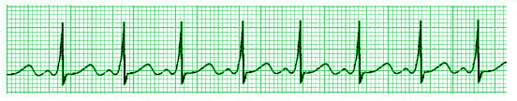
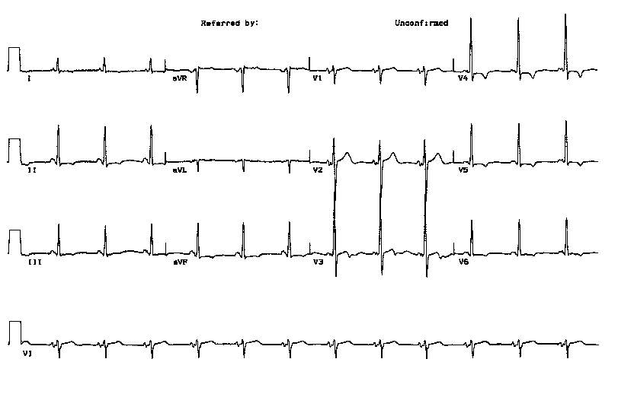
Pre-Excitation Syndromes-WPW & LGL
Accessory pathway connects atria to the ventricles, bypassing the AV node
Wolff-Parkinson-White: short PR (< 0.12 s), Delta wave (slurred upstroke QRS), slight wide QRS >0.10s, and frequently a psuedoinfarction pattern in the inferior leads and RBBB pattern.
Lown-Ganong-Levine: short PR (< 0.12 s), NO Delta wave, normal QRS & episodes of tachydysrhythmias
WPW
LGL

Slide 51
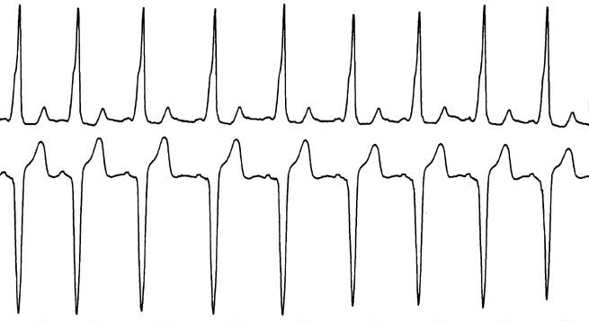
Delta waves, short pr interval, wide QRS
The underlying ECG in WPW is a fusion of the accessory pathway (delta wave) and normal pathway of the QRS. During tachy-dysrhythmias, the electrical impulse follows only the accessory pathway in a circuitous fashion.

Slide 52

Accessory Pathways-WPW
If narrow QRS d/t forward conduction, treat as SVT (Adenosine)
SA
AV
HIS
BB
Wide QRS b/c retrograde conduction –10%

Slide 53
Accessory Pathways-WPW
Wide QRS if
retrograde conduction
Adenosine, Ca channel blockers, B blockers and digitalis block the forward conduction, not the retrograde conduction. In a wide complex WPW (retrograde impulses) most AV nodal blockers stop only anterograde conduction and can allow the rate of retrograde conduction to speed up and deteriorate into Vfib! This is seen in wide complex WPW with Afib or Aflutter.
SA
AV
HIS
BB
Amiodarone and procainamide affect the forward and retrograde pathways as well as the ventricles and are safe in wide-complex tachydysrhythmias.
(Caveat: Procainamide and Amiodarone not to be used in Toursades)

Slide 54

Evaluation of Re-entry Tachycardias - QRS Width
Wide or Narrow
If the QRS is narrow, it MUST have atrial origin and conduct through the AV node in a forward manner.
If the QRS is wide, more than 0.12 seconds, consider :
Bypass tract (WPW) with retrograde conduction
SVT with aberrancy (rate-related bundle branch block)
Junctional origin
Ventricular origin

Slide 55
Re-entry Tachycardias - Treatment Modalities
Based on hemodynamic stability & QRS width
Unstable : synchronized cardioversion
Stable :
Narrow complex – vagal maneuvers, adenosine, calcium channel blockers or beta blockers
Wide complex – Amiodarone, Lidocaine or Procainamide to treat both anterograde and retrograde impulses and ventricular dysrhythmias
Beware: it is very difficulty to tell the difference between the wide-complex tachy-dysrhythmias. It is safer to treat as presumed V-tach.

Slide 56
PEARLS
Wide complex QRS tachydysrhythmias of unknown etiology – use amiodorone, procainamide, lidocaine
Differential diagnosis for rapid, irregularly irregular rhythm
MFAT
Atrial Fib
Atrial flutter with variable conduction
SVT at 150 or 300, consider Atrial flutter

Slide 57
DYSRHYTHMIAS OF VENTRICULAR ORIGIN
Idioventricular rhythms
Ventricular Tachycardia
Ventricular Fibrillation
Torsades de pointes

Slide 58
VENTRICULAR DYSRHYTHMIAS - Etiology
V Tach, V Fib & Idioventricular rhythms – typically caused by an ischemic focus which allows a rapid reentry dysrhythmia
Torsades de pointes - caused by a prolonged QT interval
Brugada syndrome – sodium ion channel-apathy

Slide 59

IDIOVENTRICULAR RHYTHMS
Mechanism : re-entry with unidirectional block due to myocardial ischemia
QRS width > 0.12 sec and rate 40 - 140
T waves typically have opposite polarity to QRS
Treatment :
Controversial, tends to be self-limited
Supportive care & close observation

Slide 60

VENTRICULAR TACHYCARDIA
Mechanism : re-entry with unidirectional block due to myocardial ischemia (Monomorphic)
QRS width > 0.12 sec and rate > 140 bpm
T waves have opposite polarity to QRS
Treatment :
Stable : Amiodarone, Procainamide, Sotolol, Lidocaine, Mag
Unstable : Unsynchronized defibrillation plus meds

Slide 61

VENTRICULAR FIBRILLATION
Chaotic ventricular depolarization with loss of organized QRS complexes
Life-threatening
Immediate loss of consciousness
Loss of blood pressure & death
Treatment : immediate unsynchronized defibrillation at 200, 300, then 360 joules (if Biphasic use ½ dose or 150j)

Slide 62


Brugada Syndrome: ST elevation V1-3 with RBBB-like pattern which predisposes to ventricular dysrhythmias.
30% mortality within 3 years.
Brugada P & Brugada J. J Am Coll Cardiol 1992;20:1391-6

Slide 63

Brugada Syndrome: Look for ST elevation V1-3
part of the syncope or palpitation work-up
immediate cardiology referral for ICD placement

Slide 64
CARDIOVERSION PEARLS
Atrial flutter is the most electro-responsive dysrhythmia
10-50 joules ~ treatment of choice
SVT and STABLE ventricular tachycardia often respond to 50 joules
Atrial and Ventricular FIBRILLATION require 100 joules or more
Biphasic defibrillators use half the joules or 150j

Slide 65

TORSADES DE POINTES
V-tach due to prolonged QT interval, in which the QRS axis alternates between positive and negative (Polymorphic)
Often self-limited, but may deteriorate into ventricular fibrillation
Treatment of Choice : Magnesium
Overdrive pacing & Isoproterenol can be used to speed the heart and decrease QT interval
Avoid procainamide and amiodarone, as can worsen QT prolongation
If refractory, defibrillate

Slide 66
Thank You
Armed Forces College of Medicine
AFCM

